Slide 1
CSE 499B
Section - 12
Group - 03
Group - 03
Md. Kamrul Islam | Farhan Ishraque | Iram shehzad | Atikul Islam Nahid

Slide 2
Project Presentation
JobCore: AI Agent to Automate Your Job Hunt in Seconds
Group - 03
Md. Kamrul Islam | Farhan Ishraque | Iram shehzad | Atikul Islam Nahid

Slide 3
ABOUT US
Md. Kamrul Islam
2211745642
Farhan Ishraque
2212002042
Atikul Islam Nahid
2211978042
Iram shehzad
2131614642
Group - 03
Md. Kamrul Islam | Farhan Ishraque | Iram shehzad | Atikul Islam Nahid

Slide 4





WHY THIS APPLICATIONS
Multiple Platforms
Time Consuming
Manual Application
Personal Feedback
Mock Interview
Group - 03
Md. Kamrul Islam | Farhan Ishraque | Iram shehzad | Atikul Islam Nahid

Slide 5
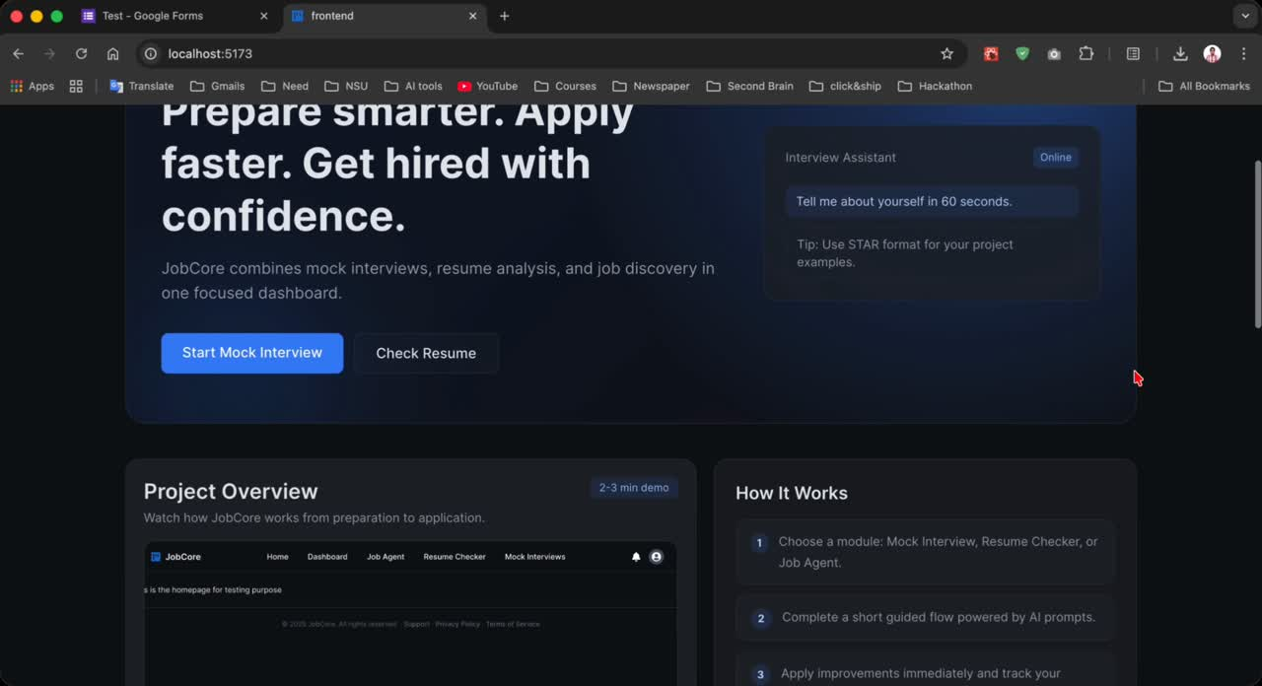
OUR SOLUTION
Group - 03
Md. Kamrul Islam | Farhan Ishraque | Iram shehzad | Atikul Islam Nahid

Slide 6
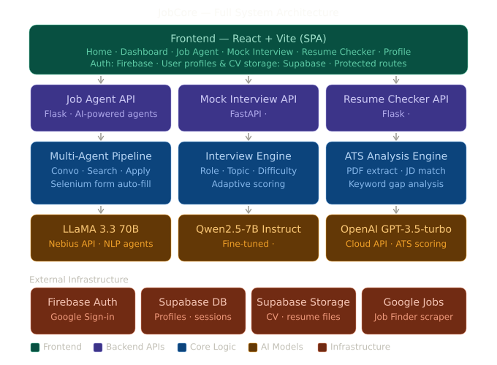
SYSTEM ARCHITECTURE
Group - 03
Md. Kamrul Islam | Farhan Ishraque | Iram shehzad | Atikul Islam Nahid

Slide 7
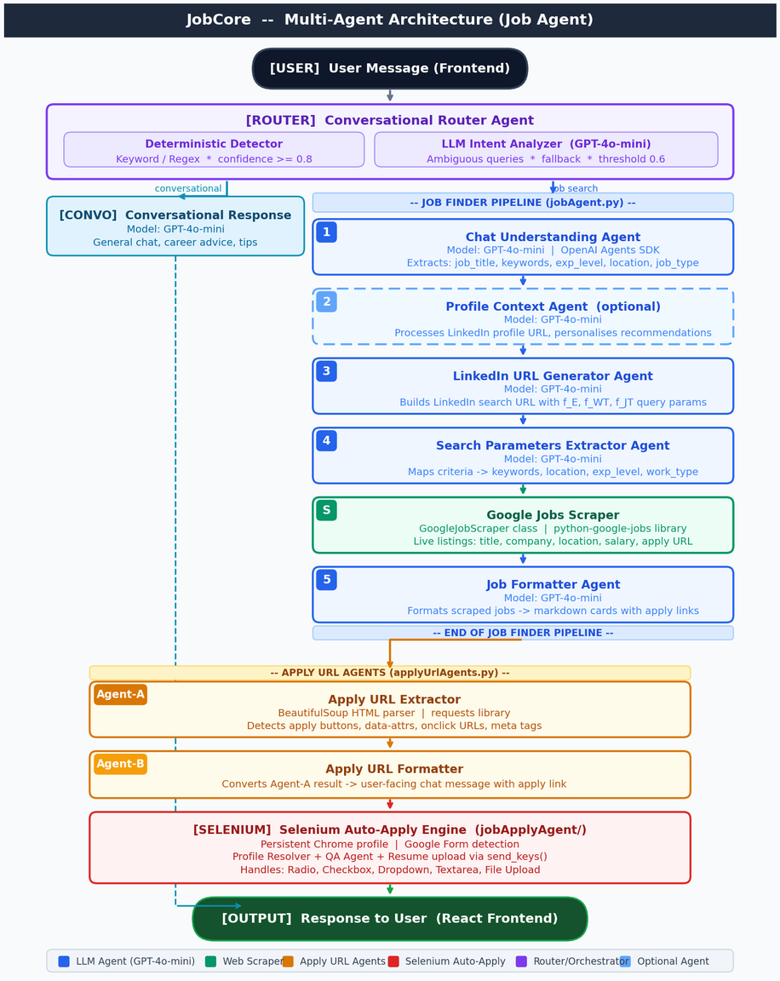
AGENT ARCHITECTURE
Group - 03
Md. Kamrul Islam | Farhan Ishraque | Iram shehzad | Atikul Islam Nahid

Slide 8











TECH STACK
Frontend
Backend
Database
Others
Group - 03
Md. Kamrul Islam | Farhan Ishraque | Iram shehzad | Atikul Islam Nahid

Slide 9
FUTURE PLAN
Fix the bugs
Launch the Beta Version
Group - 03
Md. Kamrul Islam | Farhan Ishraque | Iram shehzad | Atikul Islam Nahid

Slide 10

Group - 03
Md. Kamrul Islam | Farhan Ishraque | Iram shehzad | Atikul Islam Nahid

